Slide 1



We Can Help With…Continued
Other Support
If you don’t need us to perform a determination or full pricing reasonableness we can offer to also provide mentoring, negotiation, ongoing and other support.
What to Expect
Contact the Commercial Item Group at dcma.boston-ma.eastern-rc.mbx.commercial@mail.mil or visit our website at https://www.dcma.mil/Commercial-Item-Group/
To expedite intake, please complete and attach a customer request support form to your email. The support form is available on the DCMA CIG website.
A CIG Representative will get back to you to discuss your request.
The CIG Representative will work with you to define the scope of our support and how our team can best assist your needs.
Our technical and pricing experts will obtain the necessary information from a myriad of sources and perform the requested analyses.
A final report will be prepared for you by the agreed upon negotiated deadline.
Optional. Upon request, we provide support with negotiations, TINA waivers, legal claims, administration, or other phases.
We will also coordinate, or connect you to, the best additional resources DoD has to offer.
How Can DCMA
Commercial Item Experts
Help Me?
DCMA Commercial Item
Group
dcma.boston-ma.eastern-rc.mbx.commercial@mail.mil
Expert Guidance on
Better Technology at
Better Prices for
Better Buying Power

Slide 2

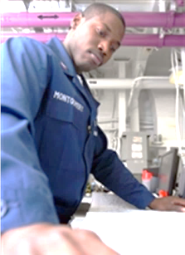
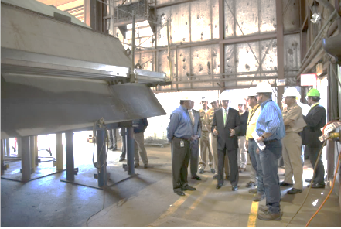
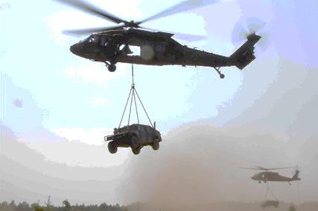
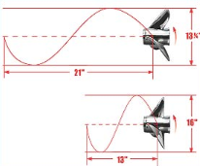

We Can Help With…
Market Analysis
We provide market research to assist you in developing effective acquisition strategies for procurement of commercial items and services. We are familiar with customary commercial practices that can be incorporated into your acquisition strategy to enhance competition and leverage cutting edge commercial technologies.
Commercial Item Determinations (CIDs)
Market research can be the key to a well founded commercial item determination. The FAR includes 8 distinct commercial item definitions that often require in-depth analysis. In difficult or complex grey areas our experts can help you make an informed commercial item determination.
Price Analysis
Establishing price reasonableness for sole source Commercial Items can be challenging and requires an understanding of commercial pricing techniques as well as market conditions. Our experts can also help you negotiations.
Training and Assistance
Besides our continuing outreach to the acquisition community, our experts can provide you with an overview of techniques and other tools used to evaluate commercial items and commercial item pricing.
Maximizing Commercial Item Benefits and Value for the Warfighter

